Slide 1
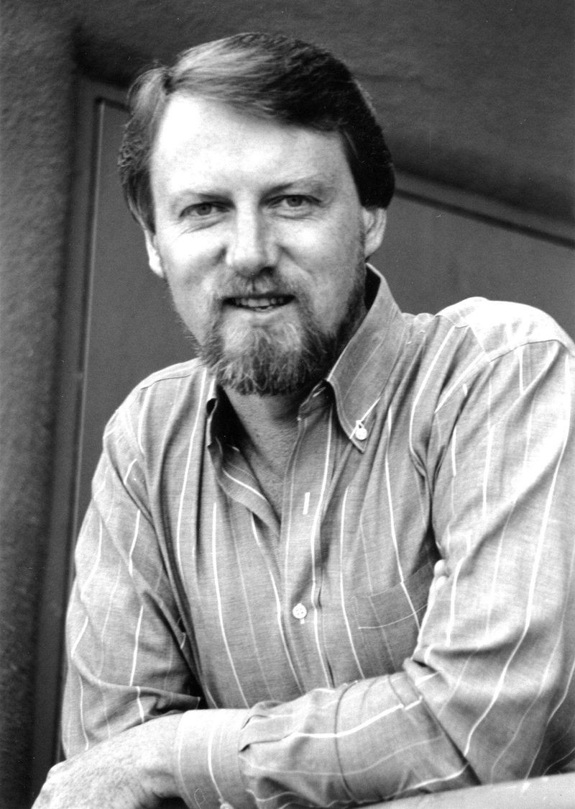
Who is Gary Kildall?

Slide 2
Brief Overview
University of Washington → Hoping to become a mathematics teachers
Grew increasingly interested in computing.
Taught at the Naval Postgrad School in California (hours drive from Silicon Valley).
Bought an Intel 4004 processor and began to experiment
Returned to UW for PhD in Computer Science. Consulting for Intel. [~1972]
Introduced data-flow analysis theory which is still used today in compiler optimization.
Notes:
Teaching at naval school was part of fulfilling mandatory draft

Slide 3
1970’s
All computers had to have specifically designed, tailor-made software.
No such thing as a ‘personal computer’.
Notes:
There was no general solution for operating systems
T

Slide 4
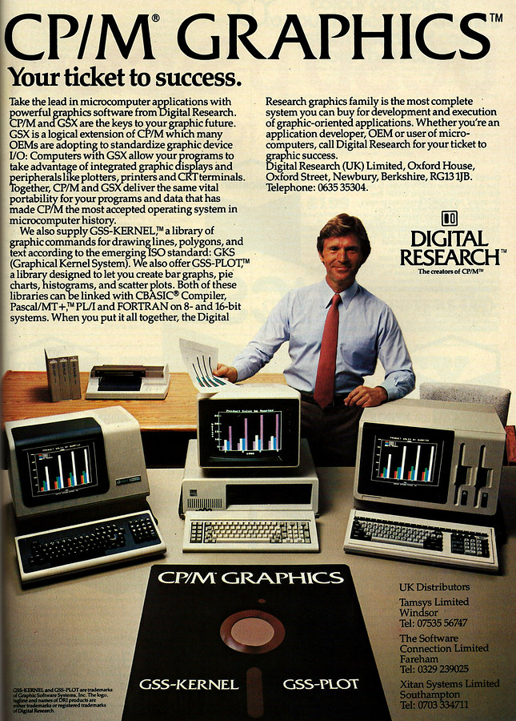
Where things get interesting...
PL/M - Programming Language for Microcomputers
CP/M - Control Programming for Microcomputers
It didn’t impress Intel. The result is [Intergalactic] Digital Research Inc.
Notes:
PL = OS for Intel 4004 microprocessor
CP = microprocessor control a floppy drive
These combined together formed the first true pc operating system
They went to pitch the top dogs at Intel
Gary was not a business man, failed to impress but as a result his wife convinced him to create DRI

Slide 5
1979
Gary had fundamentally changed the industry.
CP/M - most popular 8-bit OS in the world

Slide 6
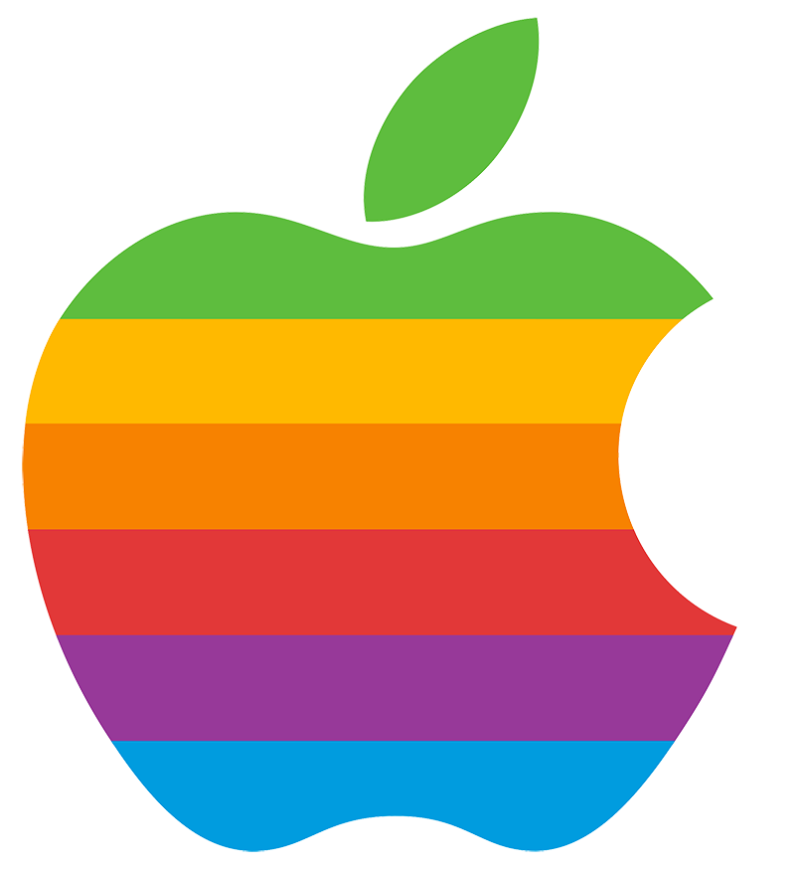
Out with the old
Microcomputers → Personal Computers
Notes:
So at this point we’re still in a place where people owning computers wasn’t really that commonplace. The ‘personal computer’ hadn’t really emerged
1976 = release of first apple computer + 1977 = apple 2 (first to be mass produced)
!976 saw the surge of personal computers and a complete change to the world and computing industry.
PC market ballooned to 1 billion dollars with only a couple of years.

Slide 7
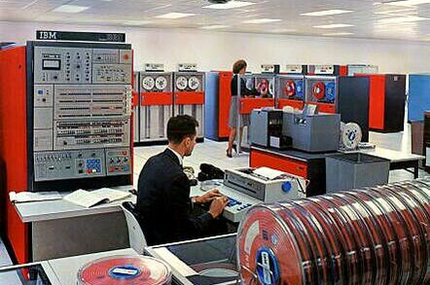

Gary and Goliath
IBM had to catch up
Created a crack team to ‘crack’ the PC market
Notes:
It wasn’t long before IBM – the tech giant of that era – took notice and decided to jump into the fray.
IBM were so large, that due to it’s size and inherit beauracrasy, decisions could often take a while. They were all known for mainframes and as a company they sort of reflected that. Large, complex and not particularly adaptable.
IBM knew it was late to the PC market and had to come out all guns blazing. In 1981, the IBM crack team tasked with

Slide 8
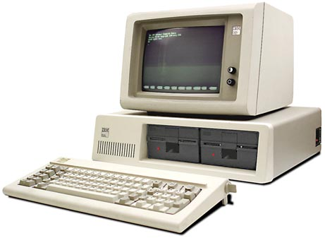
The IBM PC
Biggest tech company in the world
Huge influence
Missing one thing...
Notes:
creating the first IBM PC (IBM Model 5150) decided to buy off-the-shelf components along with software in order to expedite its entry to the PC market.Speed up and fastforward its entry into the market - which it more or less did.
Whoever had the software or operating system would be king and of huge influence

Slide 9
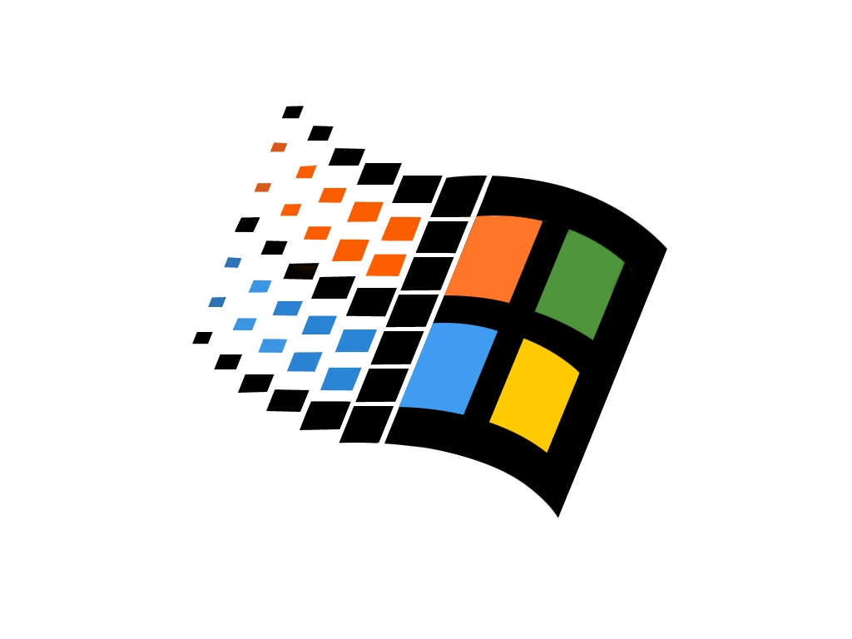
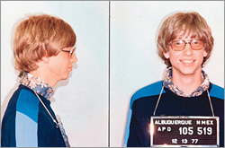
The Operating System
High stakes decision
1980’s → Bill Gates and Microsoft on the rise
But, they hadn’t built an OS
Notes:
The OPERATING SYSTEM i.e to them the software that would run the machine.
They originally mistook him for an office intern

Slide 10
The Plot Thickens (1)
Bill pointed IBM to Digital Research Inc.
IBM made him sign an NDA

Slide 11
The Plot Thickens (2)
Bill called Gary
“... treat them right, they’re important guys!” - Gates on the phone to Gary Kildall
Notes:
Gates didn’t want to waste any time, called Gary but couldn’t tell him who it was due to the NDA
URGENCY

Slide 12
The Royal Fuck Up
Gary didn’t quite get the message.
He wasn’t home when IBM arrived.

Slide 13
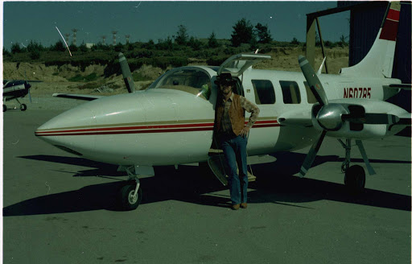
Notes:
He was out flying one of his private planes on business

Slide 14
The Falling Out
IBM team spoke with Dorothy and DRI Lawyers.
Disagreement over proposal.
Relationship damaged.
Notes:
IBM wanted a forever license on CP/M
This wasn’t something they were interested in.
Also wanted them to sign unilateral NDA which basically meant she couldn’t even say that they were there!
So it’s suffice to say that the realtionship between IBM and Gary / DRI was now poor

Slide 15
Gates and IBM
IBM returned to Gates who now saw his opportunity.
Told IBM Microsoft could provide the OS (even though they didn’t have one)
Notes:
Bill Gates was a smart, opportunistic and much more of a business man and so after DRI failure to make the deal, he jumped in to snag it. A lot of people saw this as sneaky, especially when we see exactly how it happened.

Slide 16
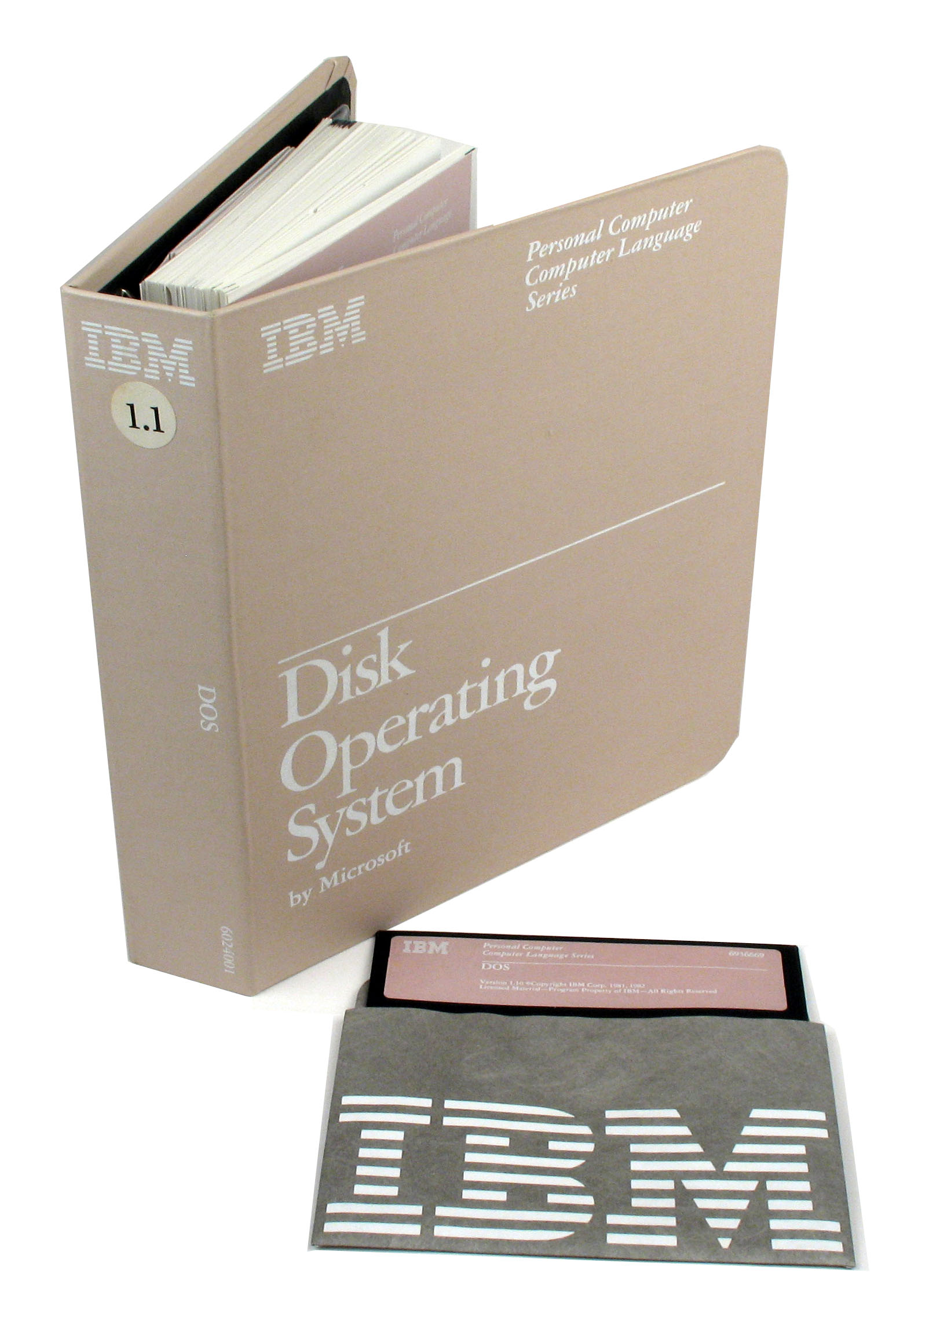
Gates and IBM (2)
Microsoft instead took Q-DOS and rebranded it as PC-DOS.
They had a deal (almost).
Notes:
Quick and dirty os → a clone of CM/P
Bought from Seattle Computer Products ($75000) rechristened
Almost had a deal, but feared legal action from Gary / DRI so decided to cut him in as well. Sort of.

Slide 17
The Dodgy Deal
IBM offered to sell CP/M alongside PC-DOS with every machine.
PC-DOS = $40
CP/M = $240

Slide 18
Game Over for Gary
Things got tough after the IBM contract.
Sold DRI (unsuccessfully).
Constant reminders of IBM / Microsoft failure, and plane flying fiasco.
Notes:
Sold DRI in last ditch effort, but that didn’t work

Slide 19
The sad end of the man who invented the PC operating system.
Gary had lost to a clone of his own creation.
Died in 1994, from head injuries sustained in a fistfight at a biker bar.
Notes:
He was so crushed he didn’t even bother suing MS or IBM
The strain of the failure led to a divorce with his wife Dorothy

Slide 20
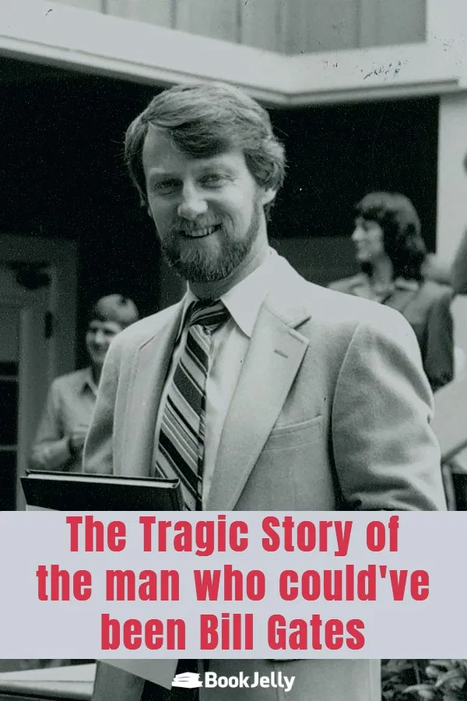
Lost in History

Slide 21

Thanks for listening!
.

